Slide 1
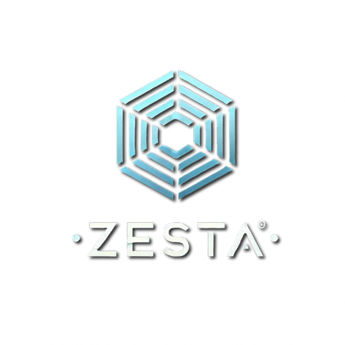

Team Members:
Divit Mittal
Meet Gudlani
ZESTA
ADS
Transparent GenAI-driven digital Ads network

Slide 2
The Need
01
Why do we need such a solution? What’s lacking in the existing services?
02
What other solutions has the industry produced to mitigate prevalent customer-dissatisfaction?
03
What can we do to build a sustainable model for Internet businesses?

Slide 3
The Problem with Existing Advertising Models
1. Invasive Data Collection & Lack of Control
2. User Dissatisfaction
3. Ineffective Targeting

Slide 4
The Problem with Existing Gratis Internet Models
Freemium
2. Ethical Data Monetization
3. Web3 Token Distribution

Slide 5
The Need for a New Solution
Zesta-Ads
Transparency: Users demand clear insights into what data is collected and how it's used.
1
2
Control: Empowering users to manage their data enhances trust and engagement.
Adaptability: An advertising model that leverages Gen-AI can offer personalized experiences without compromising user-experience.
3

Slide 6
The Proposed Solution
Our digital advertising platform aims to revolutionize the way ads are delivered and perceived by focusing on:
User Empowering UI
Developer API & Embedding Tools
Fine-Tuned Marketing-LLM
UI-Respecting Generative Image Model
Advertisers Aggregation & Bidding Back-end

Slide 7
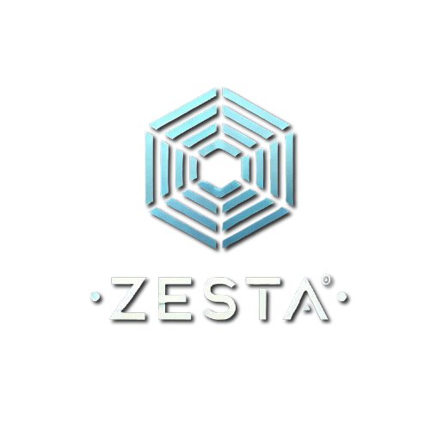
STAKEHOLDERS
Stakeholders
End-User
Advertiser
Publisher

Slide 8
Stakeholder-Benefits : End-Users
Interactive Personalization
USP
Content Here
Content Here
Enhanced Control: Users can customize their ad experience, selecting preferences and setting boundaries for data collection.
Beneficial Recommendations: Ads become more relevant and less intrusive, providing genuine value rather than unnecessary distractions.
Data Transparency: A modern UI/UX design allows users to easily understand and manage their data.
User-Specific Content: Ads feature GenAI-generated images and content tailored to individual interests.
Embedded LLM Texts: Articles and content seamlessly integrate ads, enhancing rather than disrupting the user experience.
Dynamic and Inclusive Ads: Ads match the website or app's UI, making them feel like a natural part of the platform.
Region-Specific Content: Ads are generated on the fly, incorporating local information and translating content into regional languages—a significant advantage in diverse markets like India.

Slide 9
Stakeholder-Benefits : Advertisers
Higher CTRs
Expanded Reach
Personalized and consent-based advertising leads to more effective campaigns.
Dynamic ads adapt to various platforms and user preferences, broadening the audience.
Audience Willingness for Ad Visibility:
Increased Real Estate
Ads embedded within content or UI elements provide more opportunities for engagement without overwhelming the user.
Ads are displayed to a mature and interested audience who have willingly opted for visibility, increasing the chances of engagement and meaningful interactions.

Slide 10
Stakeholder-Benefits: Publishers
Provides a more sustainable internet environment
Reduced Ad-Blocker Usage: Less intrusive and more relevant ads decrease the motivation to use ad-blockers.
Higher Revenue: Improved ad effectiveness translates to increased earnings for platforms.
Enhanced User Satisfaction: A better ad experience contributes to overall positive perceptions of the service.

Slide 11
Business Model
1. Minimal commission structure
We take a realistically minimal cut(circa. 20%) from the total advertising revenue generated across all platforms.
This minimal commission covers our operational costs and investments in technology and innovation.
2. Majority revenue distribution
Most of the advertising revenue(circa. 80%) is distributed to the publishers internet services (websites and apps) where the ads are displayed.
This approach ensures that content creators and service providers are adequately rewarded for their contributions.
3. Brand philosophy
Our brand image centers around fairness, transparency, and partnership.
By distributing the bulk of the revenue to platform owners, we position ourselves as a company that supports the growth and sustainability of internet services.
4. Sustainable growth
Our business model fosters a healthy ecosystem where users, advertisers, and platforms all benefit.
By prioritizing the success of our partners, we encourage long-term relationships and collective growth

